Slide 1






Measured Internal Temperatures in UK:
A descriptive Time Series Analysis & Modelling approach
Methodology: 4 Funerals and a Wedding
Argyris Oraiopoulos 3rd Year PhD
LoLo Student-Led Conference
16 June 2016
Supervisors: Dr Tom Kane, Dr Steven Firth, Prof Kevin Lomas

Slide 2



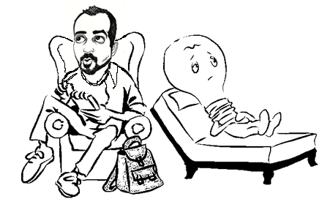
Overview
Dataset
Research Question
Year 1 – Methods 1 & 2
Year 2 – Methods 3 & 4
Year 3 – Method 5
Conclusions
Future work

Slide 3



Dataset
Hourly recorded internal air temperatures
Living rooms and main Bedrooms
228 homes in Leicester, UK
201 Bedrooms, 210 Living rooms
411 Free-floating spaces (No heating, No mechanical cooling)
62 Days, from 1st July till 31st August 2009
House Type
House Age
Wall Type
Loft Insulation
Number of occupants
Age of Oldest occupant
Type of Tenure
*All images licenced under Creative Commons

Slide 4

Research Question
Can we use empirical data
to predict internal temperatures in buildings
during summer conditions?
Objectives
Analyse data
Understand internal room temperature formation
Construct statistical models
Forecast future temperatures
t
*All images licenced under Creative Commons

Slide 5
Year 1 – Method 1
Method 1: Statistical Modelling – Internal temperature Vs External
Tools: Excel, SPSS
Daily mean of Internal temperature (°C)
2
High correlation between daily mean internal and T_{rm} across sample (R² = 0.87)
Intercept and Slope from best fit of daily mean internal against T_{rm} for every house
Relationship between intercept/slope of best fit and house characteristics.
1
0
Y = Intercept + Slope * X
  T_{rmt} = (1-α) (T_{t} + α T_{t-1} + α² T_{t-2} + α³ T_{t-3}.....)
Running mean external temperature, T_{rm} (°C)
Conclusions
No correlations found between intercept/slope and house type/house age/wall type
Correlation NOT uniform across sample
Nothing significant - Nothing Strong

Slide 6
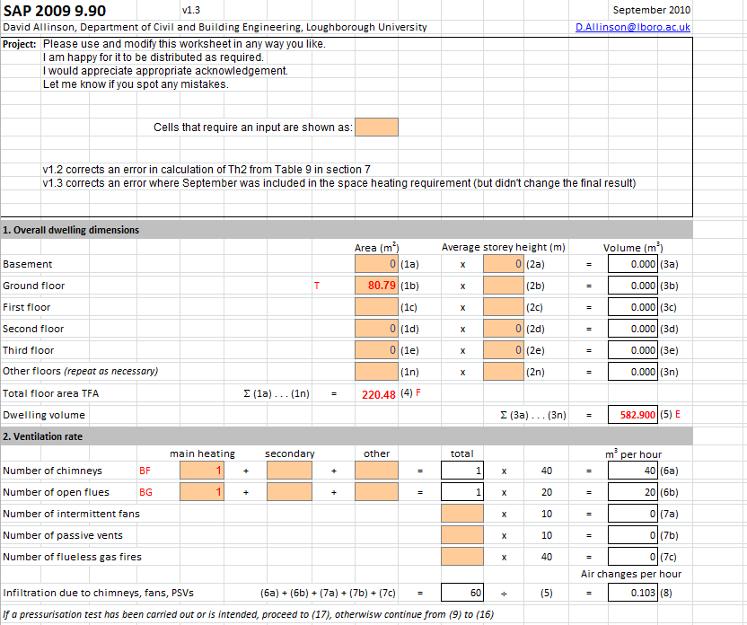
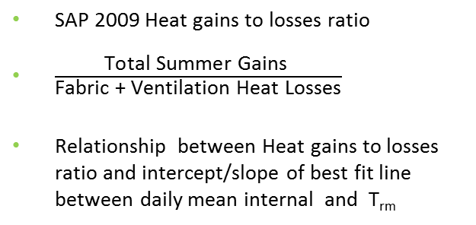
Year 1 – Method 2
Method 2: Statistical Modelling - Heat gains to losses ratio based on SAP 2009 calculation
Tools: Sap 2009, Excel
SAP 2009 Heat gains to losses ratio
$\frac{\text{Total} \text{Summer} \text{Gains} }{\text{Fabric}\text{ + }\text{Ventilation} \text{Heat} \text{Losses}}$
Relationship between Heat gains to losses ratio and intercept/slope of best fit line between daily mean internal and T_{rm}
Conclusions
Identification of weak trend
Sample decrease (230 homes to 190)
Using SAP – Extended number of inputs (Volume, U-values, orientation, glazing, etc.)
Assumptions – Uncertainty
*Permission to use SAP 2009 given by Dr David Allinson

Slide 7
Year 2 – Method 3
Method 3: Times Series Analysis & Modelling – Univariate ARIMA
Tools: SPSS, Excel
For Y_{t} , X_{t} = Y_{t} - Y_{t-1}
X_{t} = φ_{t} X_{t-1} + …. + φ_{p} X_{t-p} + ε_{t} – ϑ_{q} ε_{t-1} – ….. – ϑ_{q} ε_{t-q}
Auto Regressive
(Past behaviour)
Error
Moving Average
(Random shocks)
$T_{t}= α_{1}T_{t−1}+α_{2}T_{t−2}+α_{3}T_{t−3}+α_{4}T_{t−24}+α_{5}T_{t−25}+α_{6}T_{t−26}+α_{7}T_{t−27}$ $+ε_{t}$

Slide 8
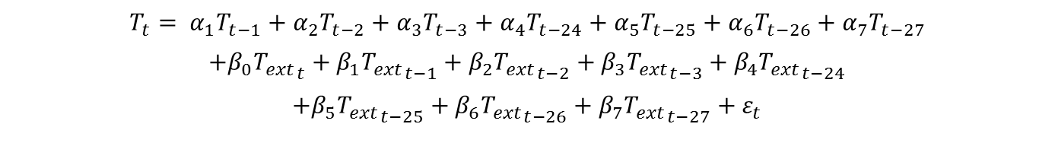
Year 2 – Method 4
Method 4: Times Series Analysis & Modelling – Multivariate ARIMA
Tools: EViews, SPSS, Excel
$$T_{t}= α_{1}T_{t−1}+α_{2}T_{t−2}+α_{3}T_{t−3}+α_{4}T_{t−24}+α_{5}T_{t−25}+α_{6}T_{t−26}+α_{7}T_{t−27}$$
$$+β_{0}{T_{ext}}_{t}+β_{1}{T_{ext}}_{t−1}+β_{2}{T_{ext}}_{t−2}+β_{3}{T_{ext}}_{t−3}+β_{4}{T_{ext}}_{t−24}$$
$$+β_{5}{T_{ext}}_{t−25}+β_{6}{T_{ext}}_{t−26}+β_{7}{T_{ext}}_{t−27}+ε_{t}$$
Direction of forecasts

Slide 9
Year 3 – Method 5
Method 5: Times Series Analysis & Modelling – 1 living room

Slide 10
Year 3 – Method 5
Method 5: Times Series Analysis & Modelling – 2 living rooms

Slide 11
Year 3 – Method 5
Method 5: Times Series Analysis & Modelling – 4 living rooms

Slide 12
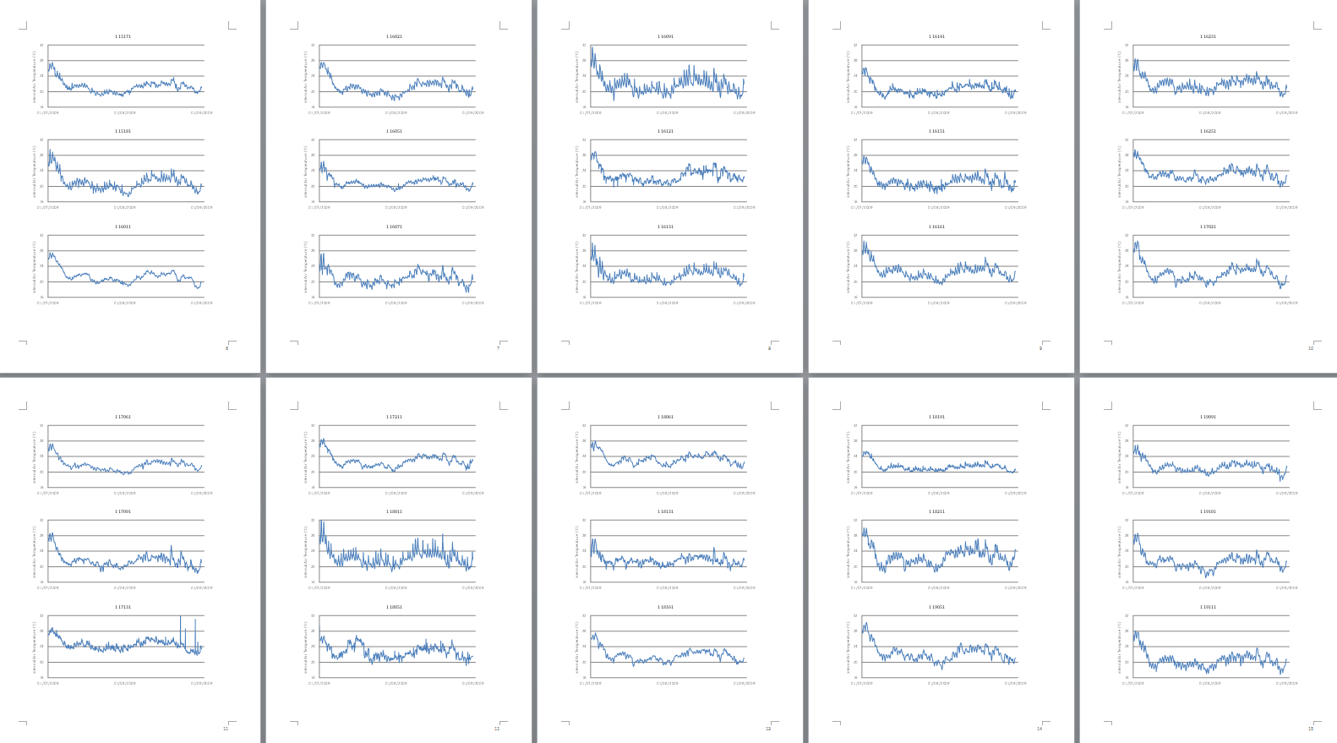
Year 3 – Method 5
Method 5: Times Series Analysis & Modelling – 30 living rooms

Slide 13
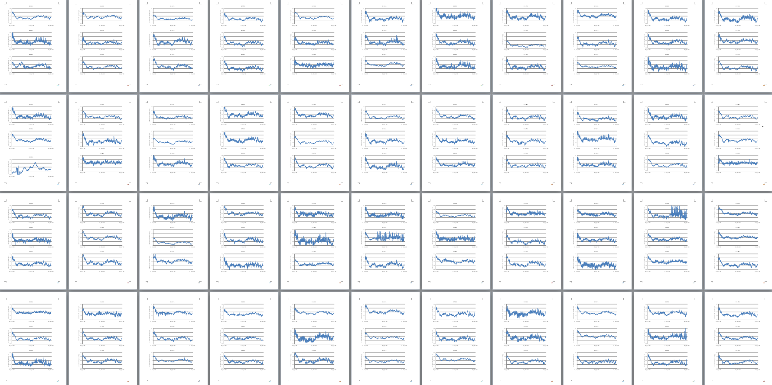
Year 3 – Method 5
Method 5: Times Series Analysis & Modelling – 132 Living rooms

Slide 14
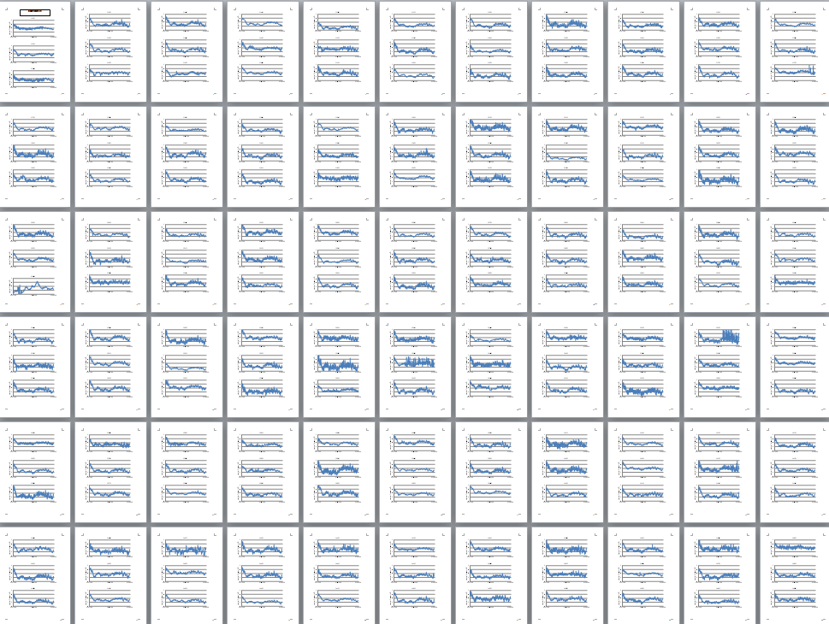
Year 3 – Method 5
Method 5: Times Series Analysis & Modelling –

Slide 15
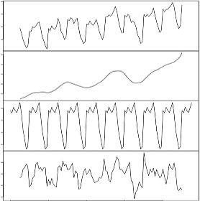
Year 3 – Method 5
Method 5: Times Series Analysis & Modelling – Descriptive Decomposition
Tools: SPSS, VBA, Excel, (Box & Jenkins, 1976)
measured
Initial Data Analysis
Y_{t}
Adjustments
Identification
trend
T_{t}
Estimation
cyclical variation
C_{t}
Model Checking
Forecasting
residual
R_{t}
Additive Model
Y_{t} = T_{t} + C_{t} + R_{t}

Slide 16
Year 3 – Method 5
Method 5: Times Series Analysis & Modelling – Identification of Trend
Tools: SPSS, VBA, Excel

Slide 17
Year 3 – Method 5
Method 5: Times Series Analysis & Modelling – Identification of Trend
Tools: SPSS, VBA, Excel

Slide 18
Year 3 – Method 5
Method 5: Times Series Analysis & Modelling – Identification of Trend
Tools: SPSS, VBA, Excel

Slide 19
Year 3 – Method 5
Method 5: Times Series Analysis & Modelling – Identification of Trend
Tools: SPSS, VBA, Excel

Slide 20
Year 3 – Method 5
Method 5: Times Series Analysis & Modelling – Identification of Trend
Tools: SPSS, VBA, Excel
$$θ_{ewma, ex, d}=\left(1−α\right)×\left({\overline{θ}}_{ex,d}+α {\overline{θ}}_{ex,d−1}+α^{2 }{\overline{θ}}_{ex, d−2}+α^{3 }{\overline{θ}}_{ex,d−3}+…+α^{m }{\overline{θ}}_{ex,d−m}\right)$$

Slide 21


Year 3 – Method 5
Method 5: Times Series Analysis & Modelling – Modelling of Trend
Tools: SPSS, VBA, Excel
$$θ_{ewma, ex, d}=\left(1−α\right)×\left({\overline{θ}}_{ex,d}+α {\overline{θ}}_{ex,d−1}+α^{2 }{\overline{θ}}_{ex, d−2}+α^{3 }{\overline{θ}}_{ex,d−3}+…+α^{m }{\overline{θ}}_{ex,d−m}\right)$$
${{\overline{θ}}_{in,d}= T}_{in, d}= f\left(T_{ex, d}\right)$ $= f\left({a,m,θ}_{ewma, ex, d}\right)$ ,
$$R^{2}=0.9$$

Slide 22

Year 3 – Method 5
Method 5: Times Series Analysis & Modelling – Modelling of Trend
Tools: SPSS, VBA, Excel
$$θ_{ewma, ex, d}=\left(1−α\right)×\left({\overline{θ}}_{ex,d}+α {\overline{θ}}_{ex,d−1}+α^{2 }{\overline{θ}}_{ex, d−2}+α^{3 }{\overline{θ}}_{ex,d−3}+…+α^{m }{\overline{θ}}_{ex,d−m}\right)$$
Simple Linear Regression for Modelled Trend ${T^{′}}_{in, d}$ :
$${T^{′}}_{in, d}={A+B × T}_{ex,d}$$
$$R^{2}=0.9$$

Slide 23

Year 3 – Method 5
Method 5: Times Series Analysis & Modelling – Identification of Cyclical (diurnal) component
Tools: SPSS, VBA, Excel
$${(Y}_{t})$$

Slide 24

Year 3 – Method 5
Method 5: Times Series Analysis & Modelling – Identification of Cyclical (diurnal) component
Tools: SPSS, VBA, Excel
$${(Y}_{t})$$
$${(T}_{t})$$

Slide 25

Year 3 – Method 5
Method 5: Times Series Analysis & Modelling – Identification of Cyclical (diurnal) component
Tools: SPSS, VBA, Excel
$$C_{t}=Y_{t}−T_{t}$$
$${(C}_{t})$$

Slide 26

Year 3 – Method 5
Method 5: Times Series Analysis & Modelling – Modelling of Cyclical (diurnal) component
Tools: SPSS, VBA, Excel
$${C ′}_{1am}=\frac{{\left(C_{1am}\right)}_{day 1}+{\left(C_{1am}\right)}_{day 2}+…+{\left(C_{1am}\right)}_{day 62}}{62}$$
$${(C}_{t})$$
$$({C ′}_{t})$$

Slide 27

Year 3 – Method 5
Method 5: Times Series Analysis & Modelling – Final Model (Measured vs. Modelled)
Tools: SPSS, VBA, Excel
$$R^{2}=0.82$$

Slide 28
Conclusions – Future Work
Univariate ARIMA
Conclusions
Don’t give up ! (despite suggestions)
R² Improvement (0.15 – 0.82)
BUT what does R² mean?
(overheating)
Solution can be too simple to look at
Multivariate ARIMA
Descriptive Decomposition

Slide 29
Future Work
Future Work
Test more Cyclical Models (include solar, sinusoidal, percentiles)
Future Weather Scenario (2030, 2050, 2080)
Dynamic Thermal Simulation Validation
Application of Model on different dataset (Passive House, etc.)

Slide 30





Questions / Discussion
Thank you
a.oraiopoulos@lboro.ac.uk
www.lolo.ac.uk
Argyris Oraiopoulos
@AOraiopoulos

Slide 31
Year 3 – Method 5
Method 5: Times Series Analysis & Modelling – Final Model
Tools: SPSS, VBA, Excel

Slide 32

Year 3 – Method 5
Method 5: Times Series Analysis & Modelling – Final Model incl. Solar Component (T_{sol-air})
Tools: SPSS, VBA, Excel
$$R^{2}=0.80$$

Slide 33
Year 3 – Method 5
Method 5: Times Series Analysis & Modelling - Identification of Trend
Exponentially weighted moving average of the external daily mean air temperature ($θ_{ewma, ex, d}$ ), using the past 15 days ($m=15$) for all values of alpha ($α=0 to 0.9$)

Slide 34
Year 3 – Method 5
Method 5: Times Series Analysis & Modelling - Identification of Trend
Exponentially weighted moving average of the external daily mean air temperature ($θ_{ewma, ex, d}$ ), using $α=0.7$ for all values of $m$ between 1 and 15.

Slide 35
Year 3 – Method 5
Method 5: Times Series Analysis & Modelling – Trend Modelling
R² values between ${\overline{θ}}_{in,d}$ of a living room (116131) and $θ_{ewma, ex, d}$ for varying m values between 1-15 days and varying $α$ values between 0.1-0.9

Slide 36
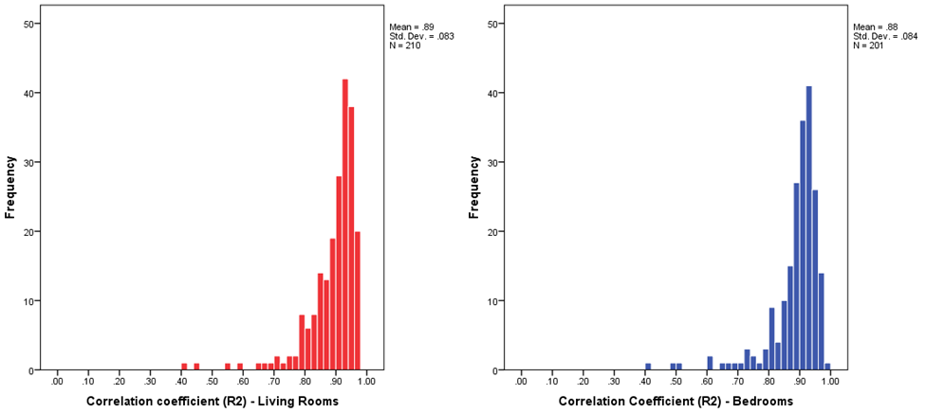
Year 3 – Method 5
Method 5: Times Series Analysis & Modelling – Trend R² values Histograms

Slide 37
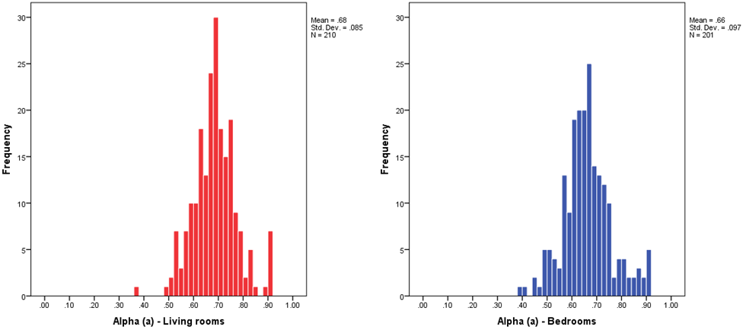
Year 3 – Method 5
Method 5: Times Series Analysis & Modelling – Trend α values Histograms

Slide 38
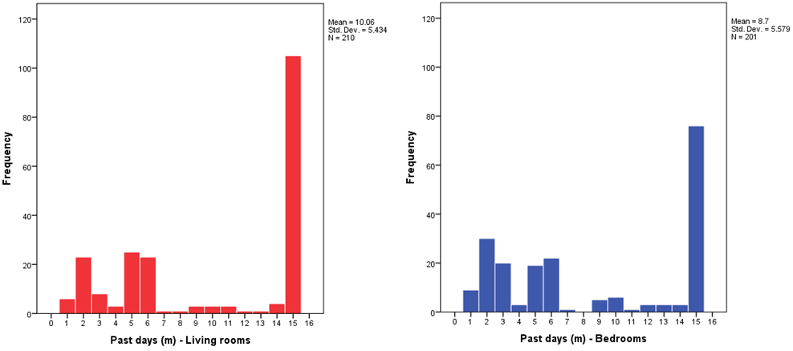
Year 3 – Method 5
Method 5: Times Series Analysis & Modelling – Trend m values Histograms

Slide 39
Year 3 – Method 5
Method 5: Times Series Analysis & Modelling – Identification of Trend
Tools: SPSS, VBA, Excel

