Slide 1
LOLO Conference 2016
EVALUATION OF RETROFIT STRATEGIES
FOR POST-WAR OFFICE BUILDINGS
ÖZLEM DURAN
Supervisors: Simon C. Taylor, Kevin J. Lomas
London–Loughborough (LoLo) Centre for Doctoral Training in Energy Demand
Loughborough University
16 June 2016

Slide 2
INTRODUCTION
  Evaluation of the retrofit
  decision making process of
  post-war office buildings (1945 ̴1980) by applying dynamic energy simulations to representative building models in order to create a guidance optimising;
      Energy reduction
      Thermal comfort
      Costs

Slide 3

INTRODUCTION
Total energy use in buildings 47%
Replacement rate 2%
Post-war nondomestic buildings
1945-1985
Diversity in built form and activity
Typical characteristic in architecture
UK commercial and public sector energy consumption by sub-sector for 2000 (Pout et al. 2002).
Total floor area percentage of age profiles of office buildings in UK (DCLG, 2005b)

Slide 4
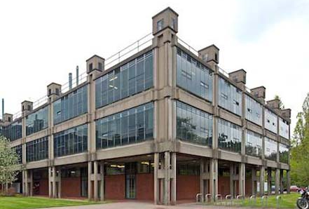
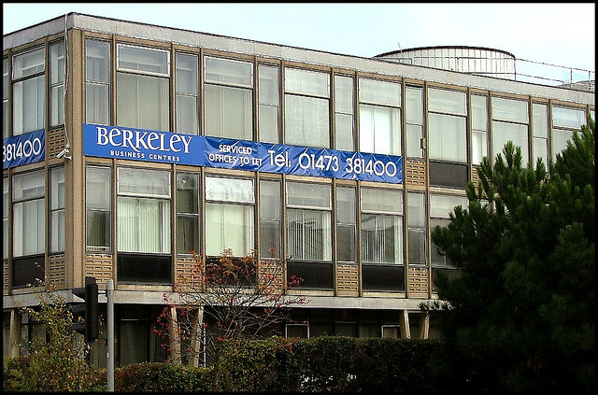
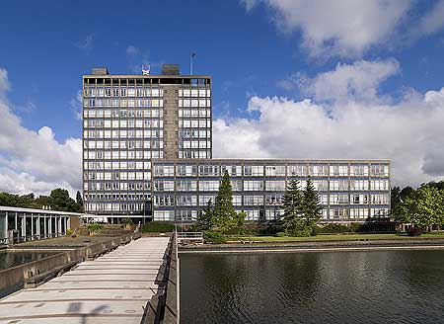
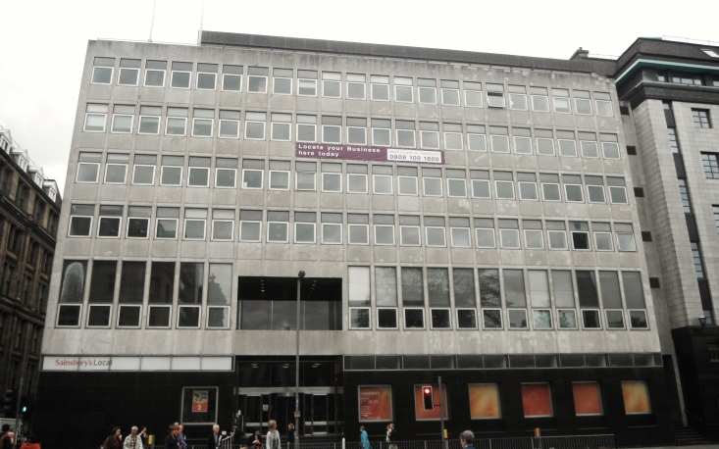
Birmingham Uni. Minerals and Physical Metallurgy Building 1957-62
Harvest House Offices 1960 Slater & Havard
Western Bank of Scotland Head Office, Basil Spence 1956 LISTED
Pilkington Brothers Head Office Maxwell Fry 1960-64 LISTED

Slide 5
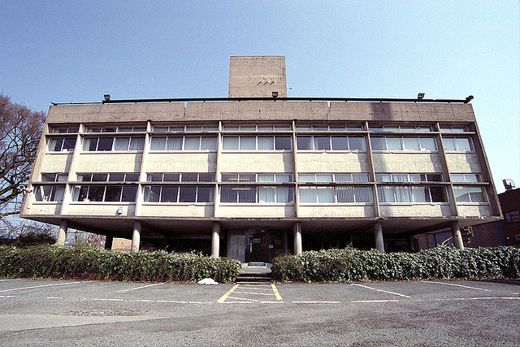
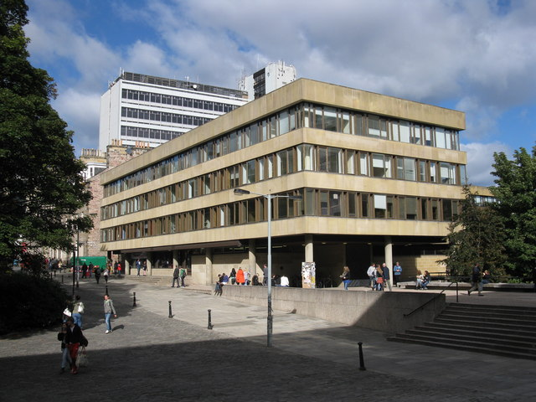



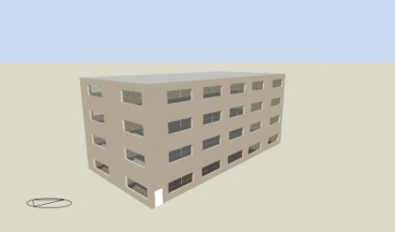
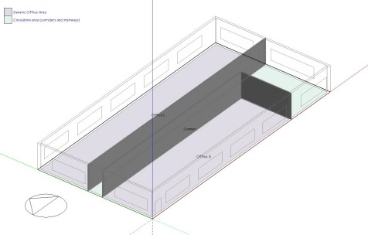
EXEMPLAR
  Corridor type plan
  Natural ventilation
  Daylighting
  High energy consumption
  Unregulated toxic materials
  Thermal discomfort
  Aesthetical problems
Cellular daylit 4 storeys

Slide 6
PARAMETERS
Physical conditions
Location
Islington
Heathrow
Weather Data
Current
2050
Orientation
0°
90°
Retrofit packages
Heating Energy Reduction
PART L
ENERPHIT
Blinds
No
Passive Cooling Energy
Overhang
No
Night ventilation
No
Active Cooling Energy
Mixed mode ventilation
+ Heat recovery
No

Slide 7
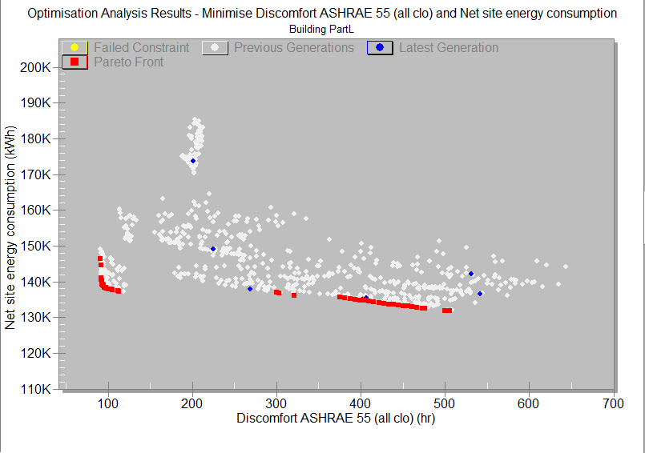
OPTIMISATION
Simulation cluster

Slide 8
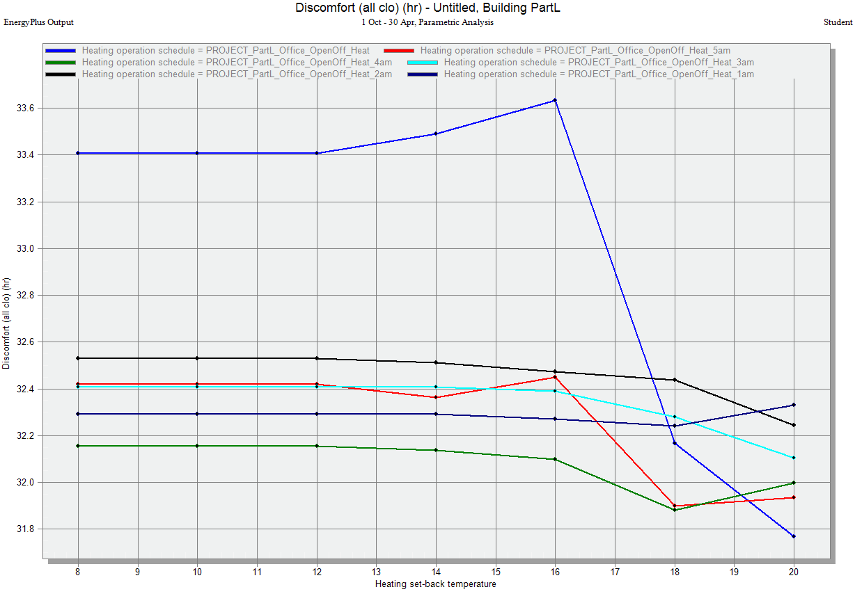
STAGE 1
Uncertainty /
Sensitivity analysis
STAGE 2
Parametric Study

Slide 9
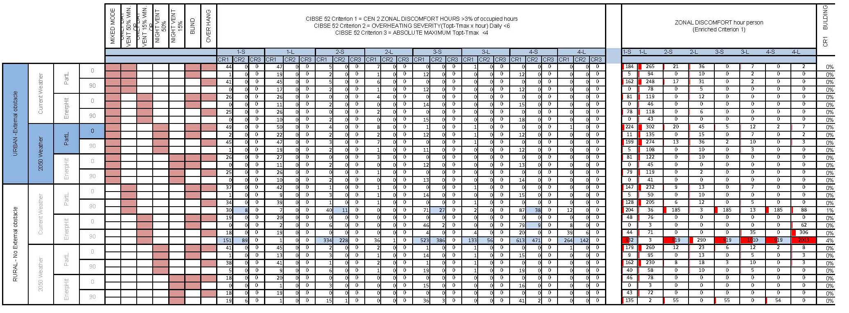
STAGE 3
Detailed analysis
STAGE 4
Final pareto fronts

Slide 10
CHALLENGES
  Dealing with the uncertainties
  Realistic
  Making correct assumptions
  Justification
  Don’t let the program to lead you
  A very good literature review
  Interview with industry
  Validation
  Write down
  Deepen the knowledge
  Realistic model; ex: limiting thermal discomfort window openings
  Building level comfort value; a new approach
  Enriched cost evaluation; discussion in progress

Slide 11


