Slide 1
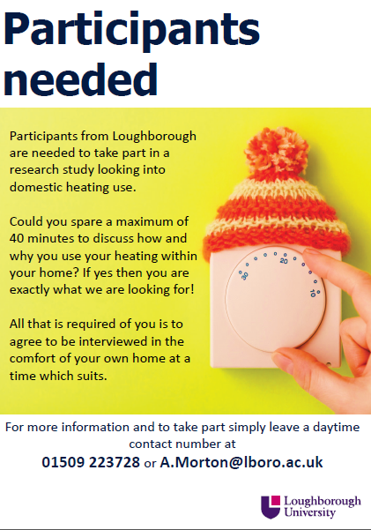
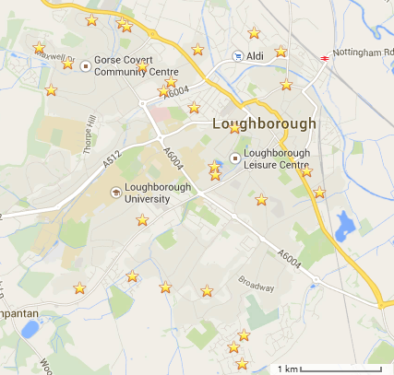
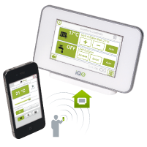
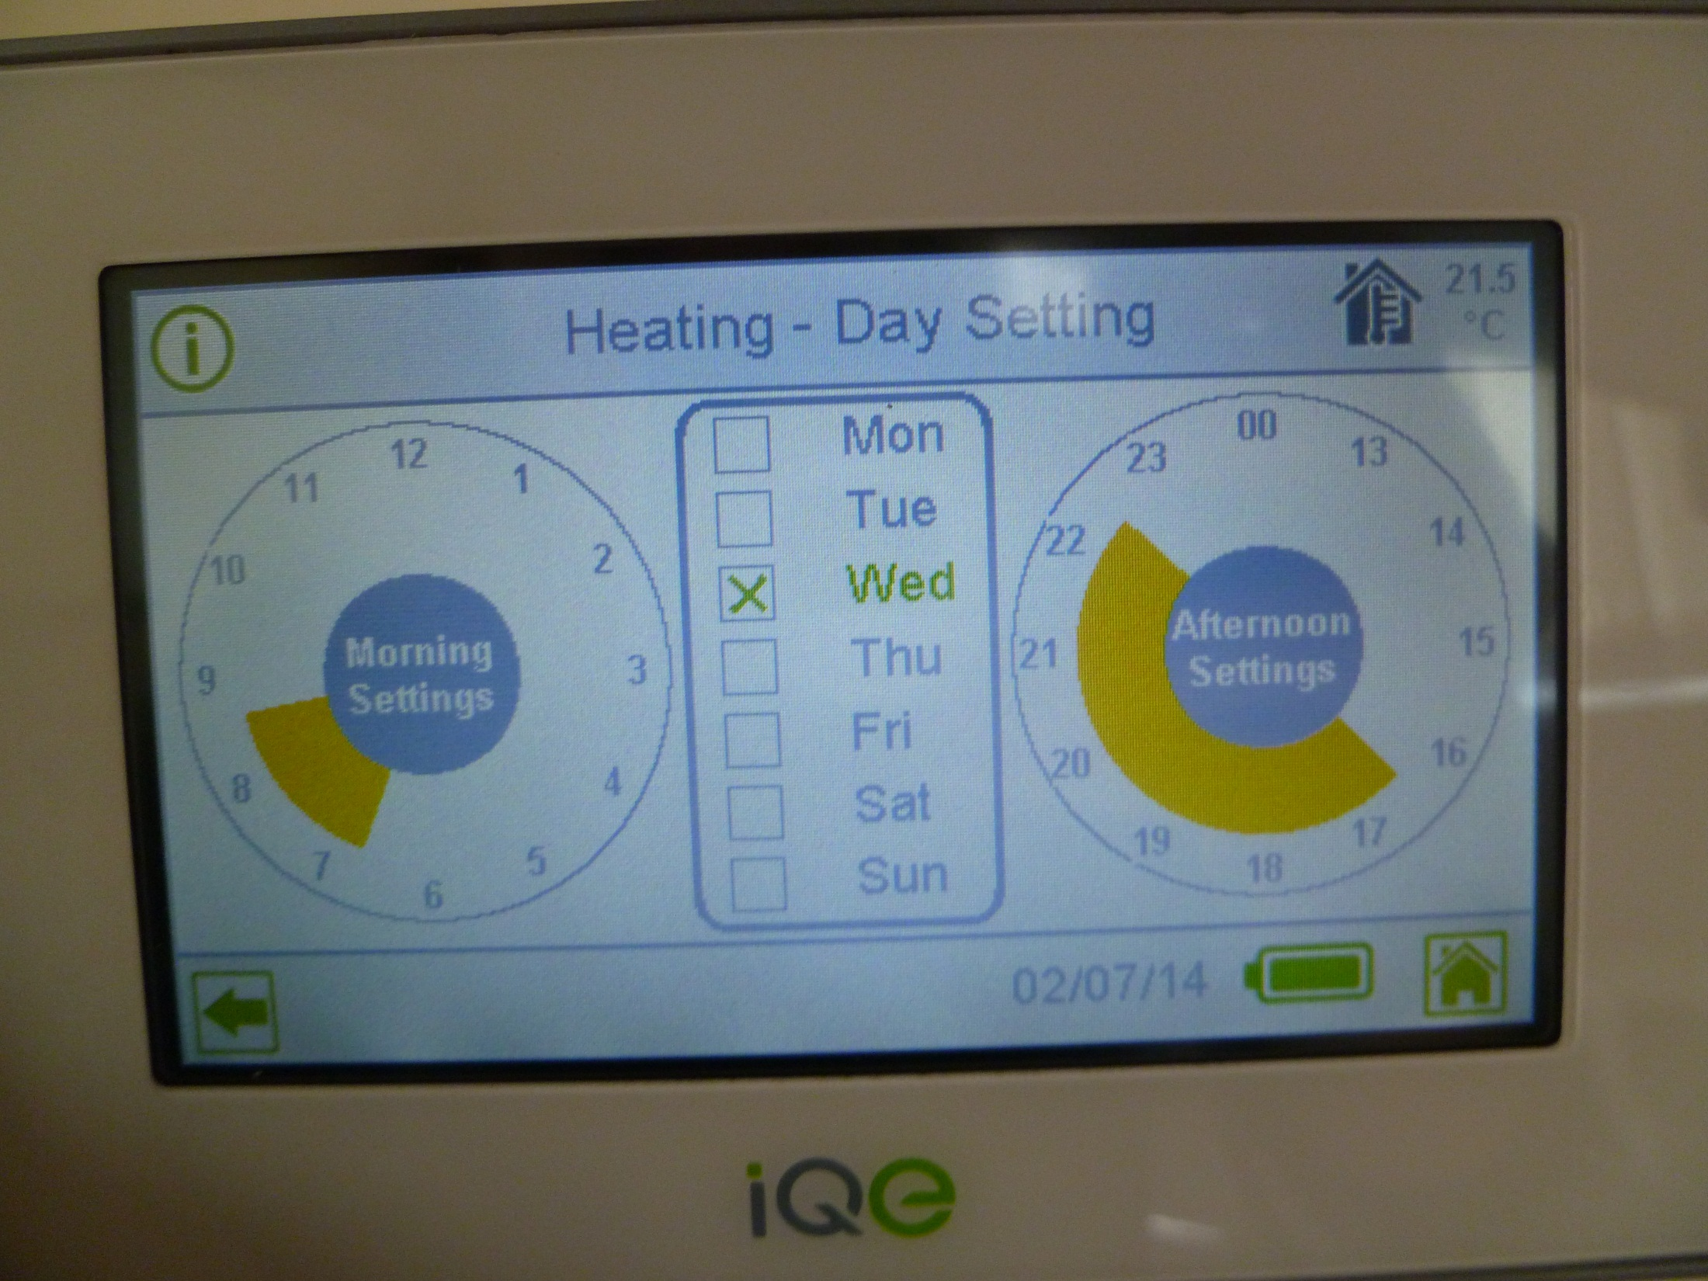
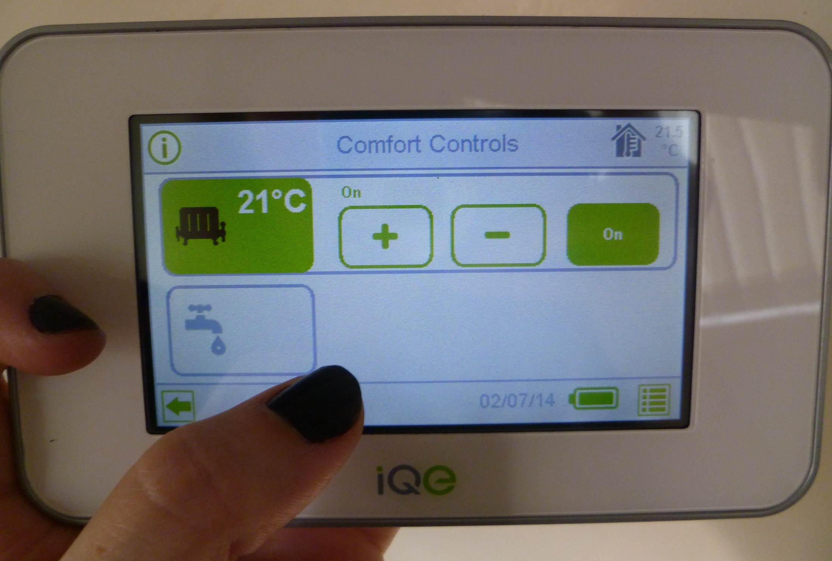
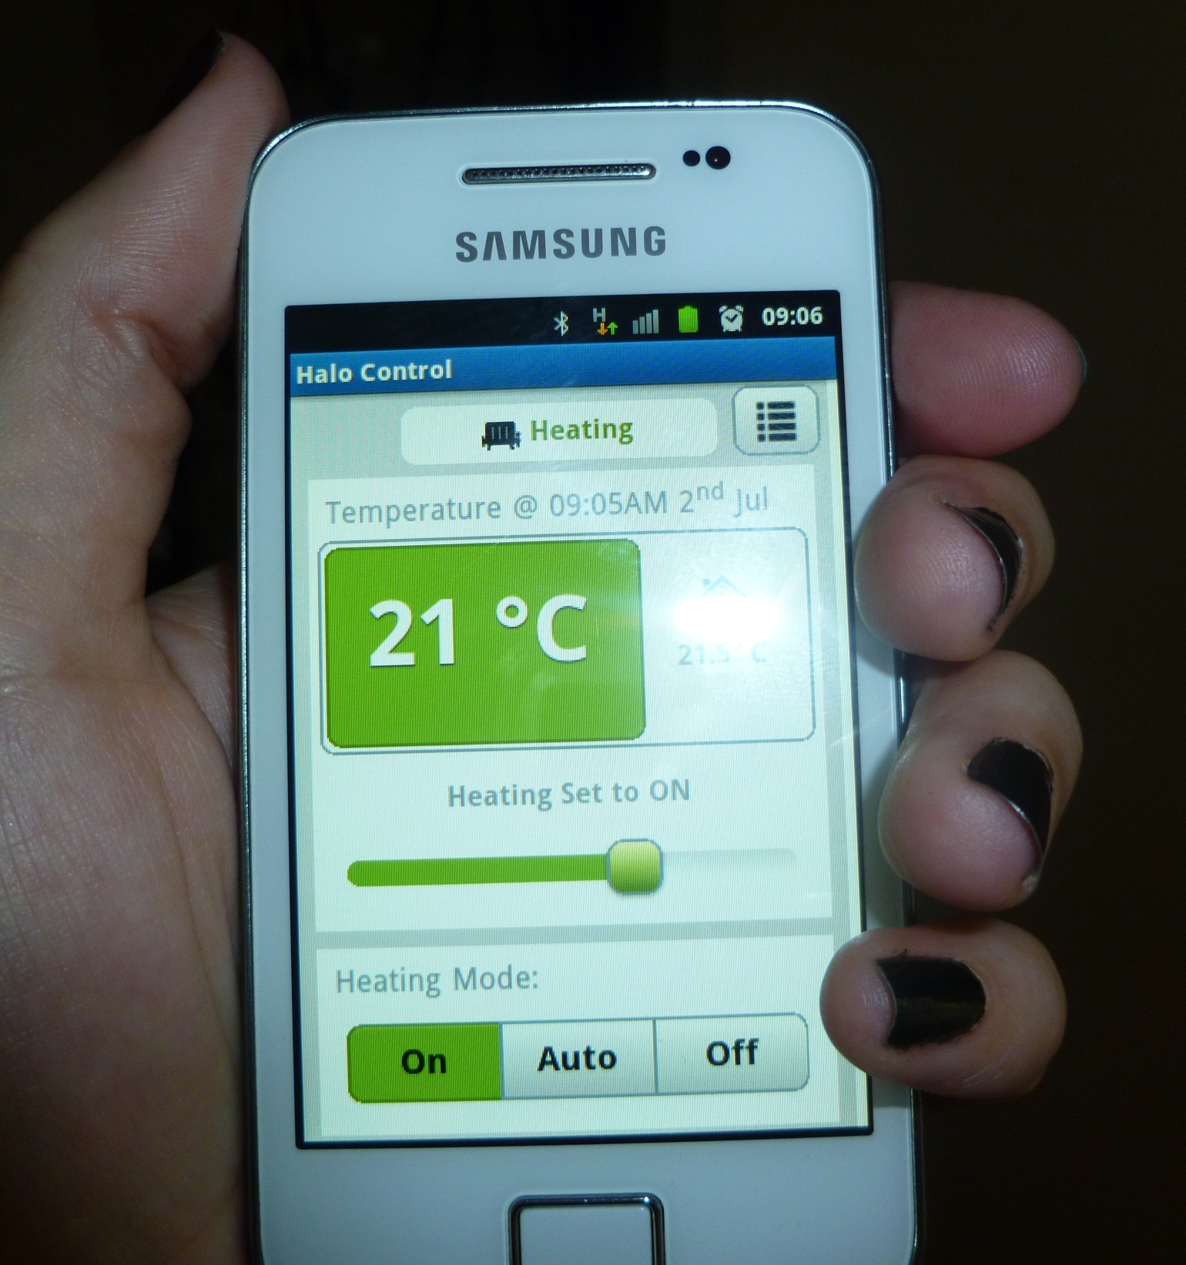
Householders’ space heating behaviour & influence of new controls - old habits die hard?
Ashley Morton PhD student, Loughborough University (A.Morton@lboro.ac.uk)
1
BACKGROUND
2
HEATING BEHAVIOURS
3
PHD RESEARCH
Domestic sector responsible for over ¼ of UK CO₂ emissions.
Currently little is known about how people behave regarding heating in their homes.
Using heating habits to classify behaviour , do new controls impact or do old habits die hard?
Identify space heating behaviour and uncover impact of new heating control technology
Phase 1 – How and why people heat their homes
Interview study
Phase 2 – Impact on behaviour of new controls
Monitor heating
Heating diaries
Interviews
DECC recently published work on characterising heating behaviours
There are five different categories, those who are hands off with their heating and the ones below;
Reactor
someone who changes their heating to changing situations such as weather
Rationer someone who limits their use of heating
Planner
someone who thinks ahead and adjusts heating to suit
Ego-centric expects a specific level of comfort regardless of heating use
Space and water heating is largest domestic energy user
New heating control technologies suggested as a means to save energy
“Buildings don’t use energy: people do” (K. B. Janda, 2009)
Mixed method approach
Qualitative focused research supported with Quantitative measurements
4
PHASE 1 STUDY – HOW AND WHY DO PEOPLE HEAT THEIR HOMES?
Factors identified as influence on heating use
Desire for comfort
Access to heating controls
Previous thermal experience
Respect for others
Health issues
Using secondary heating
Mainly qualitative focused interview study uncovering what heating controls people have and use and the reasons why.
Sample recruitment via local newspaper advertisements and randomly selected streets to leaflet
Leafleting focused to Loughborough area (stars show streets selected)
Best response rate via the local newspaper advert and word of mouth
Total of 30 households recruited
House type
Construction year
Number of occupants
Interviewee age
Broad sample recruited covering most demographics
40% high, 37% medium and 23% low incomes
Interviews typically lasted 30-45 mins with questionnaire used to get demographic information
Percentage of sample
Results show that although many have full set of controls most only interact with one to control their heating
Sample identified multiple factors behind their heating behaviour
Analysis still on going to link factors with heating methods to identify heating characters
5
PHASE 2 STUDY – DO NEW HEATING CONTROL TECHNOLOGY CHANGE HEATING BEHAVIOURS?
Mixed method study investigating heating use in homes before and after a new advanced heating control is installed.
Sample of 12 households recruited as part of a pilot for the EPSRC funded DEFACTO project
Households agreed to have an iQE branded Halo heating control system installed
Halo system allows for remote access to heating via mobile phone or website
Heating controls investigation
Phase 2 study includes quantitative data recorded via a gateway with the Halo device
Experimental tests were carried out within a test house allowing a controlled environment to help unpick the data output from the Halo controls.
Traces such as those below are achieved from the Halo;
These traces were tried and tested to see the data patterns representing;
Set schedules vs. Manual interaction vs. Remote access
The spike was identified as being a manual interaction during a set schedule
Interviews
Initial interview carried out before installation concerning heating use and perception of new heating controls
Second interview carried out between Aug-Oct reflecting on installation and initial thought of new controls
Measurements
Gas monitoring
Halo system set up with additional temperature sensors so temperatures in all rooms recorded
Heating diaries
4 week heating diary sent to householders to record their heating use as they start using it again after summer
Third interview Feb/Mar to reflect on heating use now (similar questions will be used to first interview for direct comparison)
Electricity monitoring
Temperatures measured before installation with HOBO sensors
Thermostat settings recorded
How does heating use in sample evolves over the winter
Do some houses perhaps interact more at the start of winter then ultimately leave it?
This would mean people might be more than one of the “heating characters” from literature.

