Slide 1
IEA Annex 37: Demonstration of field measurements of heat pump systems in buildings – Good examples with modern technology
Jenny Love
8th March 2013

Slide 2
What is Annex 37?
“Demonstration of field measurements of heat pump systems in buildings - Good examples with modern technology”
UK field trials:
EST phase 2
Swedish field trials
Swiss field trials
Outputs: report, website, recommendations
Notes:
The point of this annex is basically to demonstrate that heat pumps can already work well enough in real houses in a variety of countries to be worth using over existing heating methods.
So it’s quite a simple overall aim – which is to take a few case studies and show that they work in terms of energy, CO2 and money. The other thing we’re going to do now is look into the data from some well-performing heat pumps and bring out some interesting points as to when they work best and when there is room for improvement.
Each country – us, Sweden and Switzerland took a few case studies of heat pumps we all already had from field trials – for us in the UK that was the EST phase 2 data.
Here in the UK we learned a lot from Phase 1, as I’m sure you know, but in my opinion one of the main learning points was the sensitivity of the performance of a heat pump to the entire system – physical factors such as quality of installation and sizing, social factors such as occupant understanding and how they used the heat pump. This is the context really for this presentation and I’ll come back to it later.

Slide 3
Introduction to the heat pumps
Site | A | B | C | D
Heat pump type | 5 kW GSHP | 7.5 kW ASHP & 3.4 kW Exhaust-ASHP | 8 kW GHSP | 6 kW ASHP
Purpose | Space heating and DHW
Heat source | Ground - Slinky | Air and exhaust air | Ground - Borehole | Air
Heat sink | Underfloor heating & DHW | Underfloor heating & DHW | Radiators & DHW | Radiators & DHW
Refrigerant | R407C (except the Exhaust ASHP: R290)
Notes:
The 4 we chose weren’t necessarily the absolute best ones from Phase 2; they were good ones with a complete dataset, and also as you can see we took case studies which had different combinations of heat source, shape, heat sink and emitter. Note that in site B we just looked at the ASHP which was for space heating only.

Slide 4
What data do we have: temperature
Measured variables: | Site | A | B | C | D
TEMPERATURE: | External air temperature
 | Ground temperature
 | Living room temperature
 | Bedroom temperature
 | Central heating flow temperature
 | Central heating return temperature
 | Ground loop flow temperature
 | Ground loop return temperature
Notes:
From the EST data, we had a nice complete set of temperatures across each system, and we had them 5-minutely across the monitoring period.

Slide 5
What data do we have: heat and electricity
Measured variables: | Site | A | B | C | D
HEAT | Heat to space heating
 | Heat to DHW |  |  |  | No, but we can work it out from other variables
 | Total heat out of heat pump
ELECTRICITY | Electricity supply to heat pump
 | Electricity to immersion heater in the domestic hot water cylinder
 | Electricity for auxiliary space heating | Auxiliary heating was disabled |  | No auxiliary heating separate to any provided by the heat pump itself | No auxiliary heating separate to any provided by the heat pump itself
 | Electricity to compressor
 | Electricity to pump on ground loop side | No, so we take the difference between electricity to heat pump and electricity to compressor and assume a 90% : 10% attribution between the ground loop and central heating pumps respectively.
 | Electricity to pump on house side
Notes:
As for heat and electricity, we didn’t quite have everything we wanted, so this slide is just to show that where there aren’t red ticks we had to make some inferences from other variables.

Slide 6
What heat was being used for
A B C D
Notes:
Reminder that in site B we’re not looking at the hot water.
A thing to notice here is the proportional production of domestic hot water – C and D are very different. This will have significant implications later on.

Slide 7
Performance metrics
- Seasonal Performance Factors (SPFs)
- Energy, CO2 and running cost savings compared to other heating technologies

Slide 8
SPF3

Slide 9
Performance metric 1: Seasonal performance factor (e.g. SPF3)
SEPEMO definition:
SPF3 =
heat to central heating + heat to DHW + auxiliary elec
compressor elec + groundloop elec or fan elec + auxiliary elec
Site | A | B | C | D
SPF3 | 3.91 | 3.67 | 3.44 | 3.30
Notes:
Average figures: Nice that they’re working well but not that useful beyond that. We wanted to know what was contributing to this good performance, if it’s possible to know from analysing the data, and also where could they have been better.
It’s not entirely fair to compare them against each other since their monitoring periods are different.

Slide 10
SPF3: Monthly timeseries
Site A
Site C
GSHPs
ASHPs
Site B
Site D
Notes:
Overall characteristics: all between just below 3, and about 4.5.
Sudden jump – see next slide - that’s mostly to do with the heat pump not being set up correctly until September.
3) They all do quite well in Oct and Nov, compared to Dec/Jan/Feb and some cases the summer. – let’s have a look at some weather data:

Slide 11
Central heating flow (blue) and return (green) temperatures, site A

Slide 12
Monthly external temperature
Notes:
Not too cold in Oct and Nov. Colder in Dec, Jan, Feb – the heat pumps didn’t do as well in the coldest months.

Slide 13
SPF3: Daily against external temperature
SPF3 – daily averages against external temperature
Site A
Site C
GSHPs
Site B
ASHPs
Site D
Notes:
Three of them have the same general shape (& describe), and one of them has a different shape. (we’ll talk about that one later)
What do we expect the shape to be? Increasing, as external T increases and the temperature difference between the heat source and sink decreases, but then at some point people turn the heating off and DHW production takes over. So we split these into space heating and DHW, by making some assumptions

Slide 14
SPF3 - Daily against external T – split into space heating and DHW
Site A
Site C
GSHPs
Site B
ASHPs
Site D
Notes:
Do these help explain the previous ones? Well not for 418 since that’s the site where we’re only looking at the ASHP, which isn’t to do with the DHW (except??) It still has the curve shape with a maximum at 10 degrees outside. If the occupants want space heating at ext T > 10 degrees then it is provided less efficiently.
The ASHP graphs also show that the SPF3 for DHW is less than that for space heating – you’d expect that since it is heated to a higher temperature.

Slide 15
So far…
2 observations
1. DHW production has a lower SPF3 than space heating
2. The ASHPs’ performance drops off at T(ext) > 10°C
DO THESE THINGS MATTER?

Slide 16
1. SPF3 of DHW lower than that of space heating
A B C D
Notes:
Yes in some cases.

Slide 17
2. SPF3 of space heating dropping after 10 degrees outside
Site B
Site D
15%
25%
Notes:
should we worry about Spring and autumn heating? The answer is yes, since the electricity use for space heating at temperatures higher than 10°C is a significant proportion of the yearly total.
Why is it happening? The short answer is we don’t know. It could possibly be due to cycling, we’re not able to see in the data whether cycling is happening or not. Whatever it is it’s bringing down the performance of the heat pumps.

Slide 18
Savings:
Energy
CO2
Running costs

Slide 19
Performance metric 2: Savings – energy use
Energy consumption, Kwh
Energy consumption, Kwh
Energy consumption, Kwh
Energy consumption, Kwh
Notes:
Heat pumps come out well on the energy front!

Slide 20
Performance metric 2: Savings – CO2 emissions
Notes:
Heat pumps cause less CO2 emissions here but in some cases there’s not much in it compared to a gas condensing or combi boiler

Slide 21
Performance metric 2: Savings - running cost
Site A
Site C
Site B
Site D
Notes:
When we come to running cost, heat pumps normally come out better but again not by much, or in the case of site D which has a high DHW demand, they come out worse than a gas combi boiler.

Slide 22
Conclusions from UK contribution to IEA Annex 37
About performance: SPF3
About space heating
About water heating
About performance: Savings
About unknowns…
Notes:
Well-performing heat pumps in Britain could be expected to give 3.3 ≤ SPF3 ≤ 3.9
- Amongst relatively well-performing heat pumps there is much diversity in where and when the end use of the heat occurs
Space heating working very well (when they remember to turn the weather compensation on)
- Performance being brought down by DHW production. But proportion of heat used for DHW varies a lot. So the ones which have highest space heating demand compared to DHW demand get the best SPF3. This doesn’t seem like a good way to judge heat pump performance, since a less-insulated building would cause the heating demand to be proportionally high, whereas a well-insulated building, which is where we should be putting heat pumps, would have a proportionally lower heating demand and higher DHW demand.
- There are savings in energy, savings in CO2 and savings in running cost in most cases; these are very sensitive to DHW use.
- Not sure why performance of ASHPs drops off at external T > 10 degrees C.

Slide 23
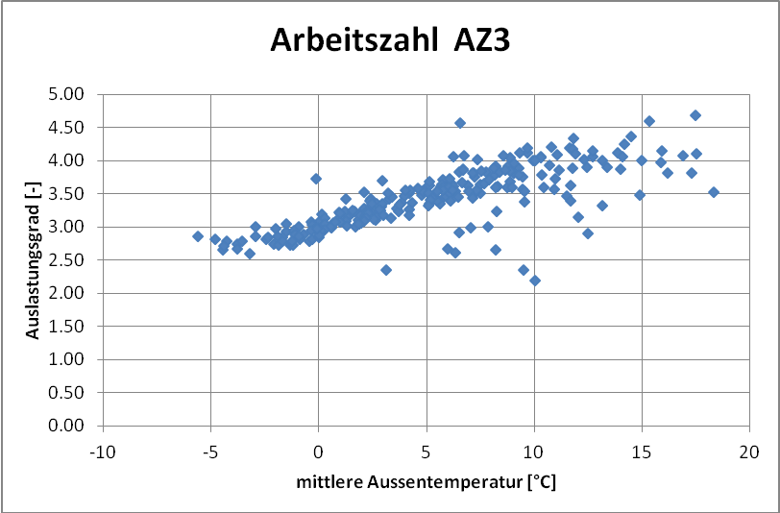
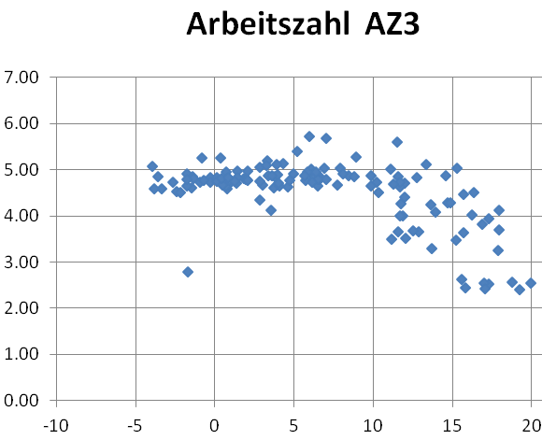
What was found in the other countries in Annex 37?
Weekly SPF 3
Weekly SPF 3
SPF3 against external temperature
SPF3 against external temperature
Mean external temperature, °C
Mean external temperature, °C
Nicolas Piezel, Fabrice Rognon, Stephanie Perret

Slide 24
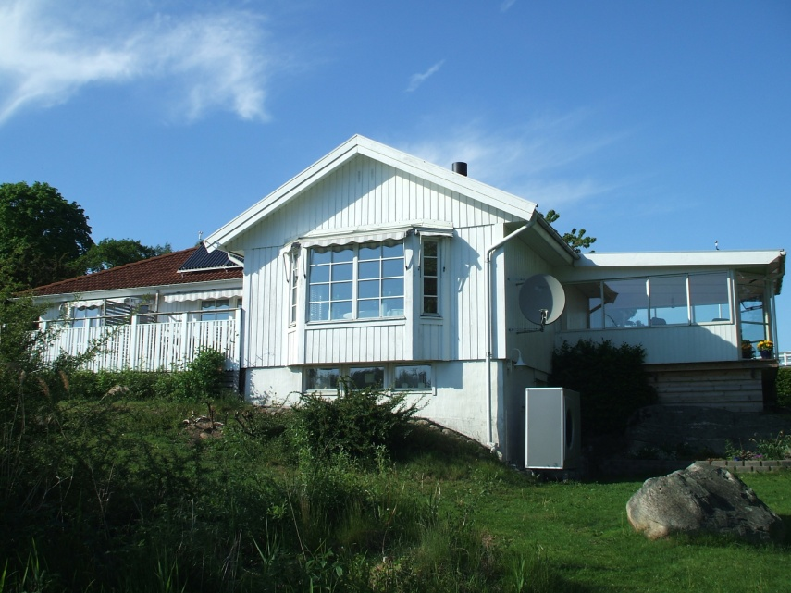
How was a SPF3 of 4.7 achieved?
Brine/water HP
Year of installation: 2003
Heating and hot water
Heat source: 2 boreholes
Floor heating system
Floor heating temperature settings: 30/25°C (for outside temperature of -8°C)
Hot water temperature settings: 57/52°C
Refrigerant: R407c
Heating system 100% HP

Slide 25
How was a SPF3 of 4.7 achieved?
From a vertical borehole, off-the-shelf heat pump, but supply temperature = 30 degrees only. Therefore you need a very well-insulated building.
- Very good performance (SPF3 > 4.5) not impossible in Britain…

Slide 26
Thank you
Any questions?
jennifer.love.09@ucl.ac.uk

Slide 27
Other information
Site | A | B | C | D
Monitoring period | 15/06/2011 – 31/03/2012 | 01/03/2011 – 31/03/2012 | 09/02/2011 – 31/03/2012 | 22/02/2011 – 31/03/2012

Slide 28
 | Site A | Site B | Site C | Site D
Estimate of heat demand (from degree day calculation), kWh | 10,378 | 13,191 | 19,983 | 8,816
Heat delivered to space heating, kWh | 10,444 | 20,788 | 12,784 | 9,146
Space heating SPF3 | 4.54 | 3.67 | 3.55 | 3.55
Heat delivered to DHW, kWh | 3,877 | - | 1,864 | 3,902
DHW SPF3 | 2.76 | - | 2.53 | 2.20
Total heat delivered, kWh | 14,253 | 20,788 | 14,648 | 13,318
SPF3 | 3.91 | 3.67 | 3.44 | 3.30

