Slide 1
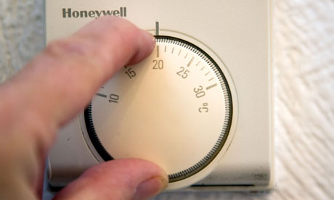
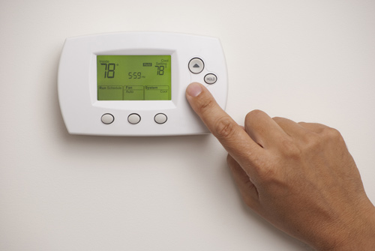
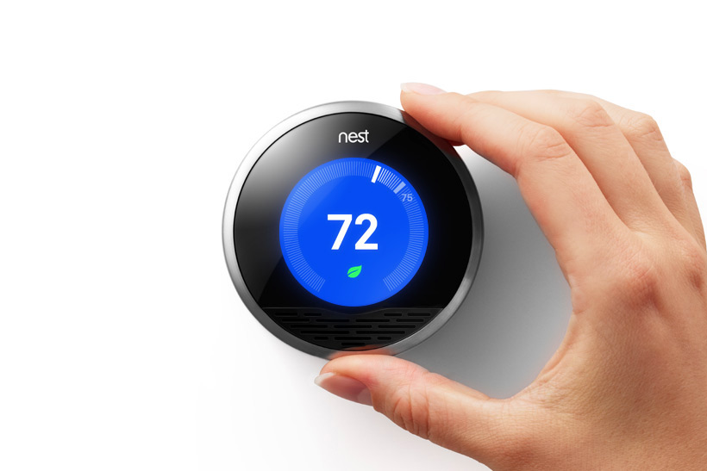
The Influence of Central Heating Installers on Space Heating Practices
Faye Wade faye.wade.10@ucl.ac.uk
Notes:
My PhD research is investigating the influence of central heating installers on space heating practices.

Slide 2
Context: Central Heating Practices
60 % of domestic energy consumption is through space heating
“Not using as much gas to keep it warm, just simmering so to speak.”
“I turn the temperature down on the boiler. I just think it’s more direct to come from the boiler, more accurate rather than the [room] thermostat.”
“I have to go in the cupboard with ladders etc”
“my ones are over the sink and you have to sort of lean across”
“we go in with a torch”
“it is in a cupboard with the tank and I can’t see half the dials”
Quotes from Rathouse and Young “Domestic Heating: Use of Controls” – Defra Market Transformation Programme, 2006
faye.wade.10@ucl.ac.uk
Notes:
I am specifically focussing on domestic space heating – this is for two reasons.
Firstly, space heating accounts for approximately 60 % of domestic energy consumption, this sector has been identified as an ‘easy fix’ due to the low cost measures that can potentially reduce consumption. Secondly, the user of the system, that is the householder, largely determines the energy consumed by the system.
Research has shown that consumers often struggle to use their central heating systems, this has negative implications for both the energy consumption of the system and often occupant comfort. To illustrate this I’ve included a few quotes from a piece of research conducted for Defra, which used focus groups to investigate the usability of controls.
The first quote is from a man who has the heating on all the time, rather than intermittently, under the justification that more gas is used if you have to heat the house up from a colder temperature. The authors mention that views on this subject were influenced by what people had heard from family, friends and official information.
Central heating systems use both boiler thermostats and room thermostats, the second quote demonstrates that occupants do not know the difference between the two. The boiler thermostat controls the temperature of the water flowing through the system, whilst the room thermostat controls the temperature of the space. This participant is using the boiler thermostat under the assumption that it controls the room temperature.
The final series of quotes demonstrate a common issue, which is location of controls – if people cannot access their controls, how can they be expected to use them?
So, the problem here is that we have unsustainable consuming practices, which are based on incorrect operating information and physical parameters of the system.

Slide 3
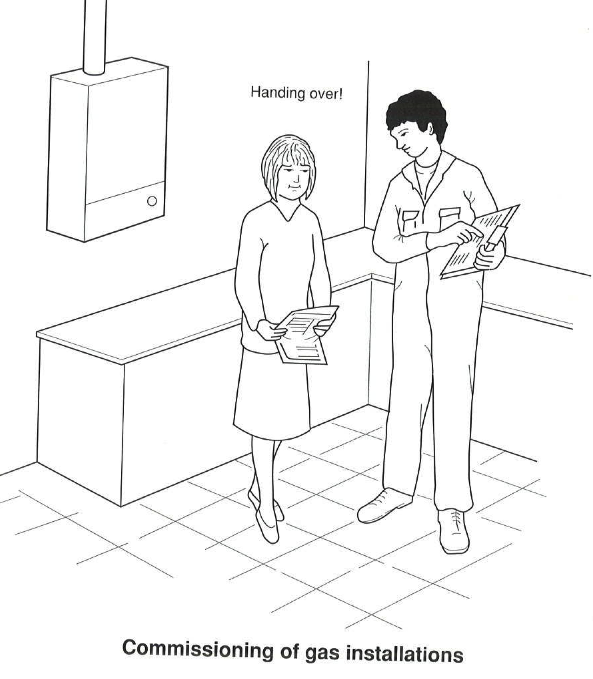
Installer as Intermediary
“People reported asking installers, plumbers and engineers to show them how to use their controls and sometimes to set their programmers.”
“Intermediaries do not occupy a neutral position in dealing with other actors. They may well mediate or facilitate, but are by no means benign in the work they perform.”
(Guy et al. 2011 p. 6)
Source: R.D Treloar, Plumbing, 3rd Ed., Blackwell Publishing, 2006
faye.wade.10@ucl.ac.uk
Notes:
This leads us to question who influences the system configuration and the user’s knowledge of their system? And to what extent does this knowledge influence consequent day to day usage practices?
In their investigation for Defra, Rathouse and Young commented that people reported asking installers, plumbers and engineers how to use their controls and set their programmers – suggesting that they are influential in this process. This research argues that installation is a process of knowledge transfer, where information provided by the installer; which may include myths, technical and tacit knowledge, can become embedded in the householders’ practices.
The plumber acts as “an intermediate agent or agency; go-between or mediator”, and so may be defined as an intermediary. Guy et al. note that this intermediate position is not always a neutral one, consequently, the information the installer exchanges with the householder may influence their everyday central heating practices.
One of the key points of knowledge transfer may be the handover process – a process during which the installer is required to handover relevant documentation and information to the householder.

Slide 4
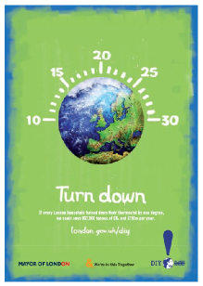
Theory: Social Shaping of Technology
Actors
Technologies
Social Structure
faye.wade.10@ucl.ac.uk
Notes:
Throughout the research, I will be drawing on theories from the Social Shaping of Technology.
The social shaping of technology suggests that a person or actor in a network cannot be treated as a separate entity to the technology they are using, nor can the technology be considered as independent from the society that has shaped it, or the individuals that use it – consequently, we come to the idea of a socio-technical system or network, illustrated by the three way relationship illustrated here.
The important factor here is that technologies shape social practices, but that social actors also shape technologies.
During the installation process, the installer acts as a temporary user of the system, as a system designer and as an informant to the householder. And so, they shape the physical configuration of the technology and the way in which it is used by the householder.
Understanding this relationship, that is, the way in which the plumber and householder interact and the consequent adoption of a new technology by the householder, could contribute to improved policies to target the use of domestic central heating. Previously, policy has focussed on the technical and the social separately. For example, ensuring that newly installed boilers are operating at a certain efficiency addresses the technical, whilst campaigns to turn down thermostats attempt to address the social. Policy currently does not address the two together, or indeed, the point at which they interact, this is a potential contribution of this research.

Slide 5
Method: Ethnography
“Ethnography is the production of highly detailed accounts of how people in a social setting lead their lives, based on systematic and long-term observation of, and conversations with, informants.” (Payne and Payne, 2004, p. 71)
Observation
Unstructured Interviews
Document Analysis
Photographs
Quote
Work Carried Out
Handover
faye.wade.10@ucl.ac.uk
Notes:
In order to understand the interaction between the householder and the installer, I am using an ethnographic approach. This is essentially collecting a detailed picture of the installation procedure – using observation, photographs, unstructured interviews and possibly document analysis.
This approach is the most appropriate to capture the detailed information required for understanding these interactions, however, it does pose some challenges.
Access is a key issue, particularly because a central heating installer’s schedule is uncertain and often subject to last minute changes. There are several stages to a central heating ‘job’ – each of which entail different types and levels of information exchange, these could be quotation stage, the actual work being carried out and the handover stage. I am currently in the process of conducting some scoping studies to refine the types of jobs I want to investigate, at what stages I need to be present for observation and the practicalities of conducting fieldwork of this nature.
Any suggestions, questions, ideas for approaching these difficulties are most welcome!

